Slide 1
Small Data Center using Raspberry Pi for Video Streaming
Research proposal

Slide 2
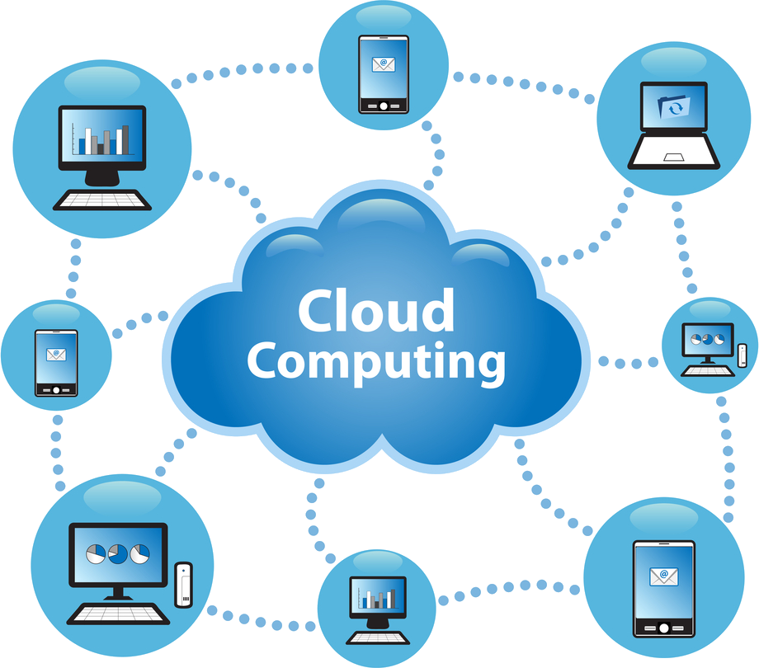
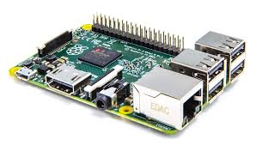
State of the Art
Cloud computing
Data servers
More lightweight portable device
Power consumption
Raspberry Pi
Small device
Low power usage
Cooling

Slide 3



The problem
Lot of data bandwidth usage
Unefficient algorithms
Servers require to much power

Slide 4
Research Question
How well does the Raspberry Pi perform in small scale data centers with video streaming?
How to answer??
Sub Questions

Slide 5
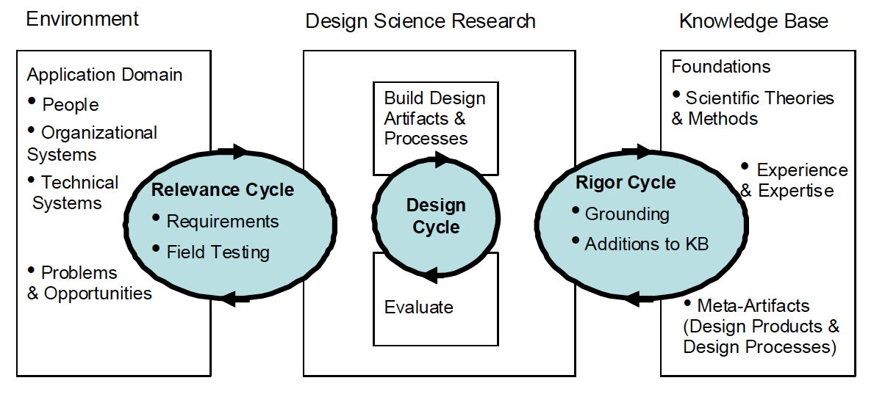
Research Method
Hevner
Design research

Slide 6
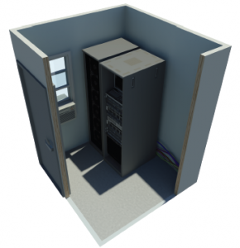
What are small scale data centers with video streaming and why are they used?
Less expensive
Can be placed behind bottleneck
Space
Cooling

Slide 7


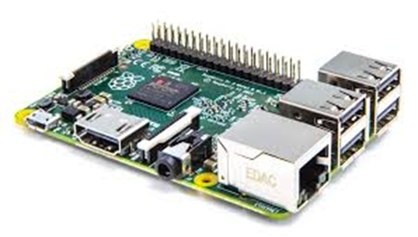
Is the Raspberry Pi’s usable for video streaming?
Streaming over HTTP
Throughput (I/O internet consumption)

Slide 8

How to fit the Raspberry Pi's into a data center considering cooling, space allocation and power?
Previous projects
Power
Cooling
Location

Slide 9
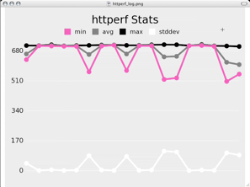

What setup does a Raspberry Pi cloud with video streaming require?
Operating system
Testing environment
Software
Previous projects

Slide 10
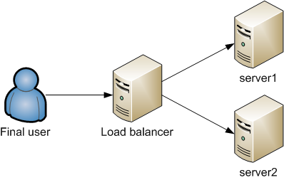
How is availability in a Raspberry pi cluster with video streaming affected by various load balancing techniques?
Performance
Availability
Different techniques
Notes:
Performance (power usage, I/O throughput)
Availability (bandwidth)
Different techniques

Slide 11

Planning
April-May: Building Test environment,
every week answer one research question
Week 20: Check for coherency and make conclusion
Week 21: Make abstract and finalize paper
Week 23: Deadline paper
Week 24-25: Make presentation
Week 26: Conference

Slide 12
Questions?

